Slide 1
Animal Research Project
The Animal Name
By Your Name

Slide 2
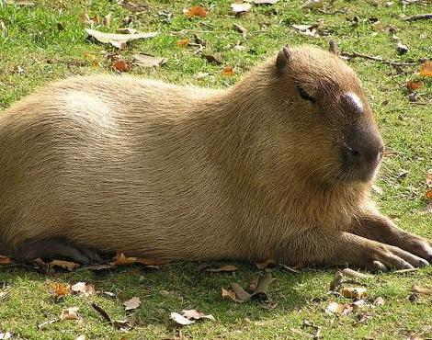
My animal is the ________.

Slide 3
What does it look like?
It is a mammal.
It has __________________ colors.
It can grow up to ____ inches.
It can weigh up to _____ lbs.
It can run up to _____ miles per hour.

Slide 4
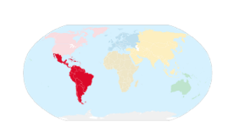
Where is it found?
It is found in ______>

Slide 5
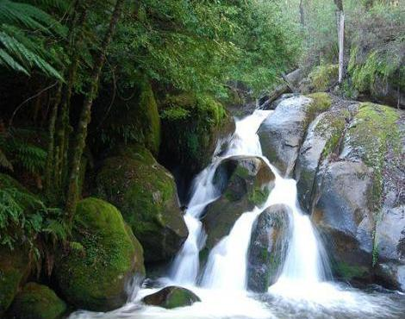
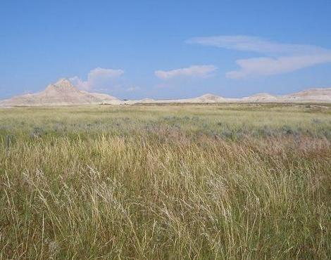
Where is its habitat?
It lives in the _________________________!

Slide 6
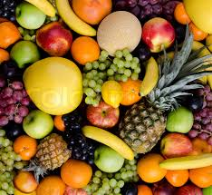
What is its diet?
It is an herbivore, omnivore, carnivore.
It eats ___________________.

Slide 7
Interesting Facts
1.
2.
3. It sounds like this:

